Slide 1
RSE
21st October 2024

Slide 2
PSHCE / SMSC / RSE
Notes:
Today we will mostly discuss RSE which stands for relationships and sex education. RSE is taught as part of our PSHE curriculum in PSHE we aim to prepare our students to become well-rounded members of wider society. They learn about various cultures, lifestyles, health both physical and mental as well as economic factors that impact life in the real world. Our curriculum is written to encompass the Concordia Academy school community in every step of learning, we address the specific needs of our very diverse community of learners, educators and parents. The curriculum is varied and covers the areas outlined on the screen we will examine RSE further but do not hesitate to ask for more information about any of the other topics covered in PSHE.

Slide 3
Why is PSHE important?
PSHE education helps children and young people to stay safe, healthy and prepared for life's challenges and opportunities (PSHE Association, 2021). PSHE has been shown to benefit pupils, schools and parents in supporting children and having a trusting environment to share discussions.
Notes:
As you can see the above quote outlines the very important reason why PSHE is a part of our curriculum in every year group. Having a judgement free, safe environment to discuss concerns allows our learners to be better equipped to face life in the wider world.

Slide 4
Background information
Parents* are an important source of learning about relationships & sex.
Most parents feel they should have a role as relationships & sex educators, and research suggests that approximately 50% of parents feel confident to do so.
Many parents report that they would like to feel able to discuss relationships & sex with their child.
The majority (over 85%) of parents support the teaching of relationships and sex education.
Approximately 6% of parents feel that relationships and sex education should be taught only at school, and approximately 6% of parents feel that it should be addressed only in the home.
Notes:
The role of parents in the development of their children’s understanding about relationships is vital. Parents are the first teachers of their children. They have the most significant influence in enabling their children to grow and mature and to form healthy relationships.

Slide 5
Our ground rules
Notes:
We talk about the importance of PSHE lessons taking place in safe and judgement free environments for children to feel comfortable to share their own experiences. The ground rules are highlighted at the start of every lesson these ensure that children can express their views without the fear of judgement, we ensure children are aware that they do not have to agree with opinions of others but be respectful of them.

Slide 6
RSE
We understand that pupils must be provided with an education that prepares them for the opportunities, responsibilities and experiences of adult life.
A key part of this relates to relationships and health education, which must be delivered to every primary-aged pupil. Although not statutory to deliver sex education outside of the science curriculum at primary level, the DfE recommends that all primary schools should have a sex education programme in place, which we are in agreement with and have included in our curriculum.
We understand our responsibility to deliver a high-quality, age-appropriate and evidence-based relationships, health and sex curriculum for all our pupils. This policy sets out the framework for our relationships, health and sex curriculum, providing clarity on how it is informed, organised and delivered.
Notes:
The most important part of this is that we ensure the learning is age appropriate. In the technology age children have a wealth of knowledge at their fingertips but the internet can do more harm than educate. We want to ensure that our pupils have the relevant knowledge conveyed in age appropriate and safe environments where they can pose questions.

Slide 7
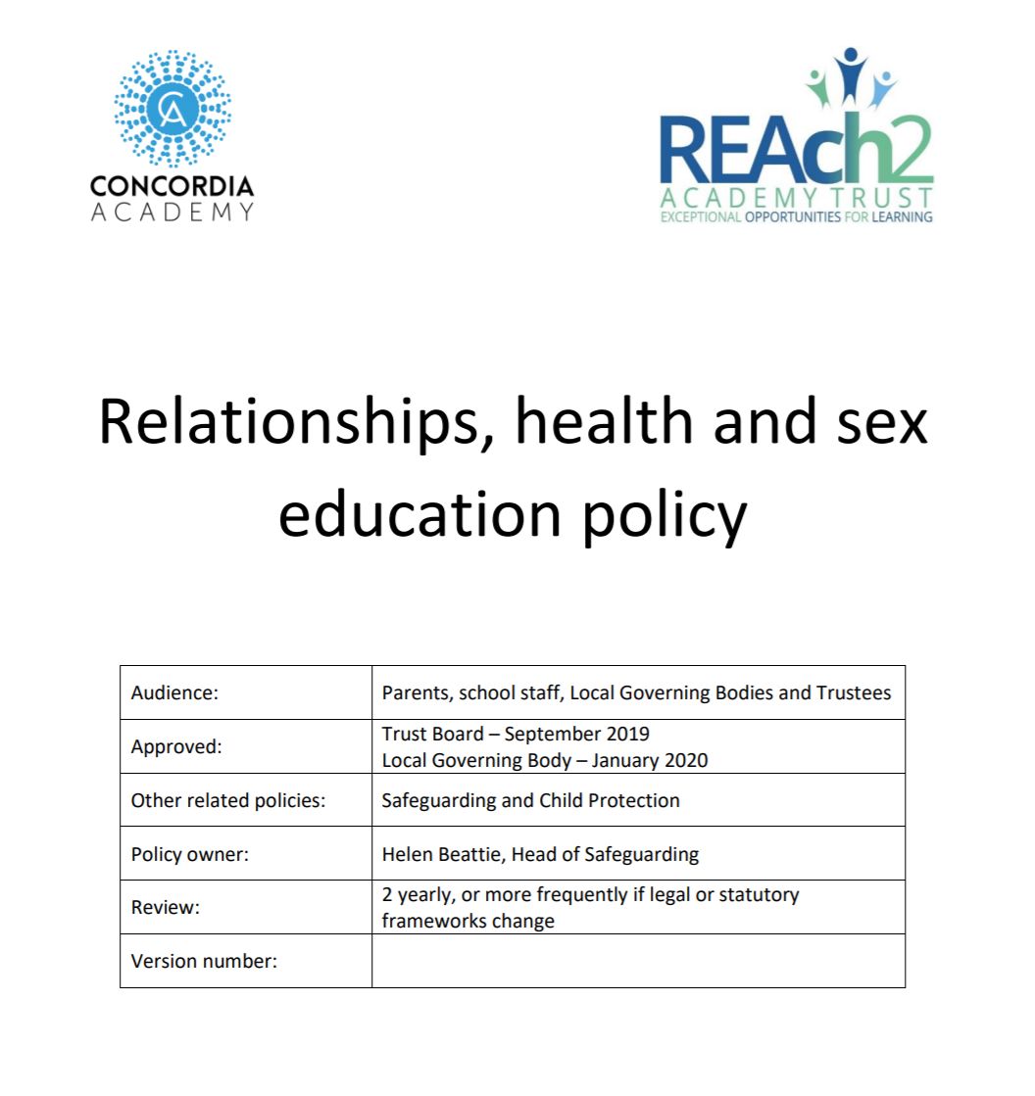
RSE Policy
Our policy can be found on the website and details our responsibility to deliver a high-quality, age-appropriate and evidence-based relationships, health and sex curriculum for all our pupils.

Slide 8
RSE Policy
Our policy can be found on the website and details our responsibility to deliver a high-quality, age-appropriate and evidence-based relationships, health and sex curriculum for all our pupils.

Slide 9
Our responsibilities
Class teachers will:
· Deliver a high-quality and age-appropriate curriculum in line with statutory requirements
· Use a variety of teaching methods and resources to provide an engaging curriculum that meets the needs of all pupils
· Ensure they do not express personal views or beliefs when delivering the programme
· Model positive attitudes to relationships, health and sex education.
· Respond to any safeguarding concerns in line with the Safeguarding and Child Protection policy
· Act in accordance with planning, monitoring and assessment requirements for the subjects
· Liaise with the SENDCo to identify and respond to individual needs of pupils with SEND
· Work with the Senior Leadership Team and curriculum leaders to evaluate the quality of provision

Slide 10
Ground rules
Before doing any activity with RSE outcomes, children and staff set and agree ground rules. These ground rules should aim to ensure that the all the children are able to access their basic human rights:
To be able to learn;
To feel and be safe;
To feel and be respected.
Before the lessons take place, time will be given for the pupils to think of what rules they must follow to ensure these rights are met.
Discussing sensitive subjects with their peers in a safe and respectful environment develops maturity and mutual respect.

Slide 11
Parents/carers will:
· Support school staff to shape the curriculum for relationships, health and sex education
· Communicate openly and constructively with school staff regarding relationships, health and sex education
· Attend, or contribute to, any consultation or information sessions regarding the delivery of relationships, health and sex education
· As per the DfE statutory guidance, parents and carers have the right to request that their child be withdrawn from all or part of the non-statutory sex education curriculum. Any requests to be withdrawn from non-statutory sex education must be made in writing to the Headteacher at the earliest opportunity.

Slide 12
Parental right to withdraw
Parents have the right to request that their child is withdrawn from any sex education that is further to the sex education contained within the National Curriculum for Science.
Parents cannot withdraw their child from learning contained within statutory Health Education or Relationships Education.

Slide 13
Curriculum coverage
Along with the curriculum letter, you will have been sent a summary of the yearly overview for your child’s RSE. Along with the lesson plans, the yearly summary can also be found on our website.
https://concordiaacademy.co.uk/curriculum/phse/

Slide 14
Questions

